Slide 1
Evidence that the TOM cannot be right in all cases
Ulrich Schumann, Oct 2024

Slide 2
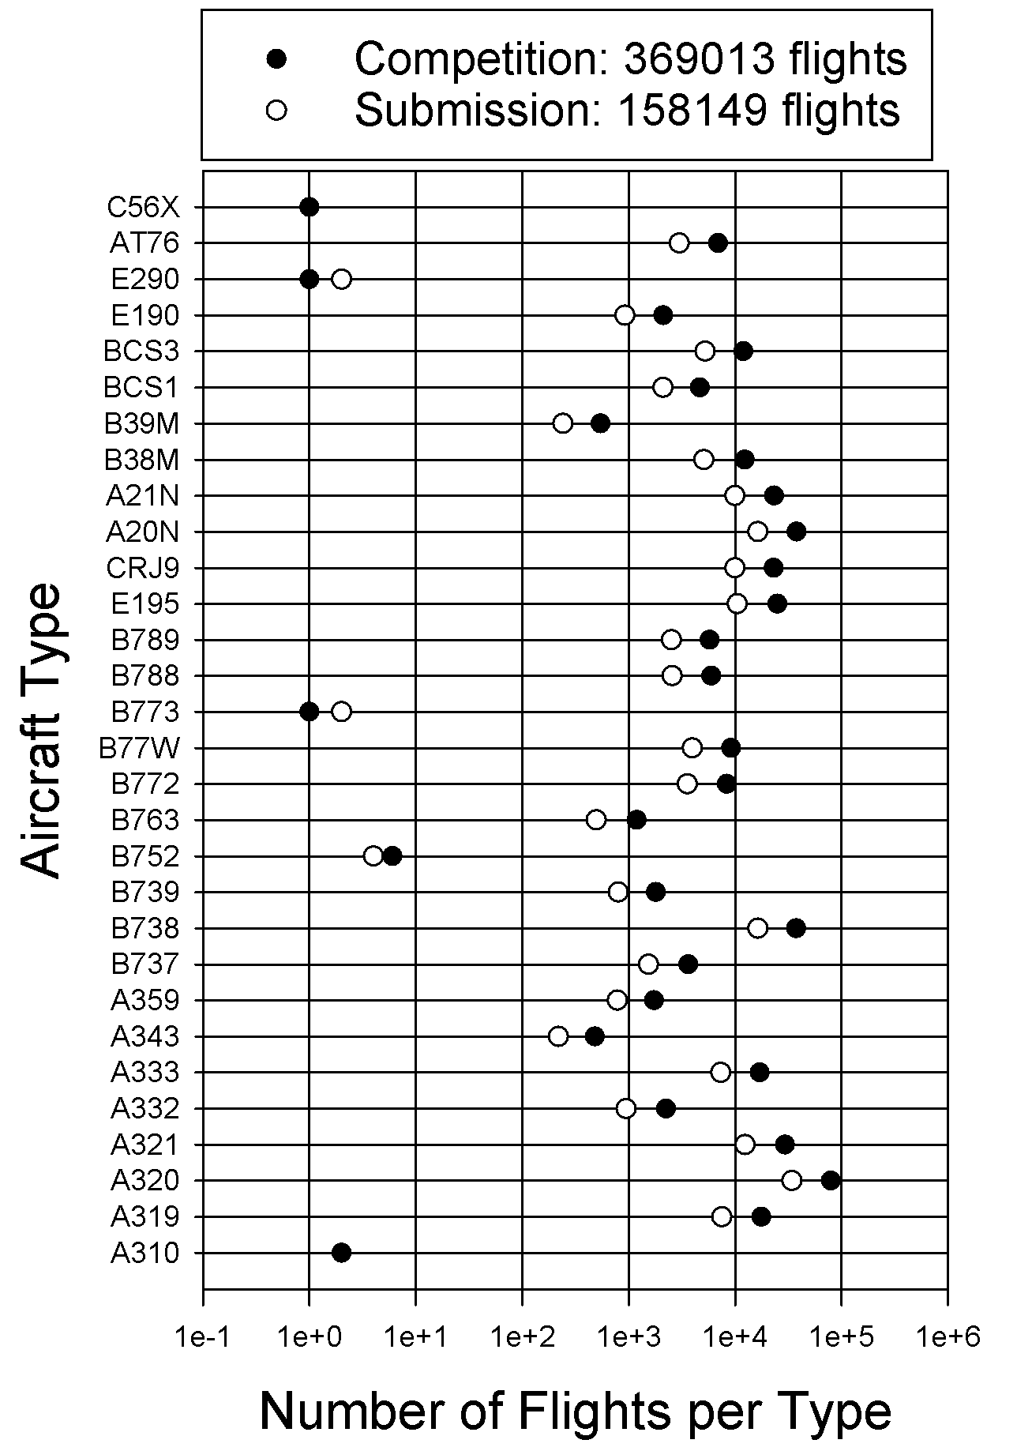
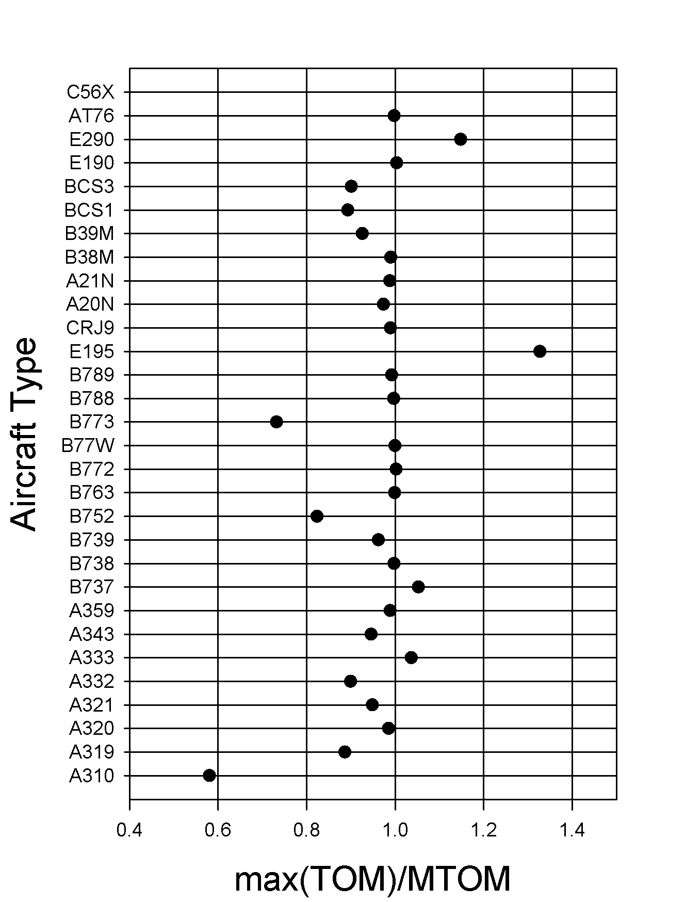
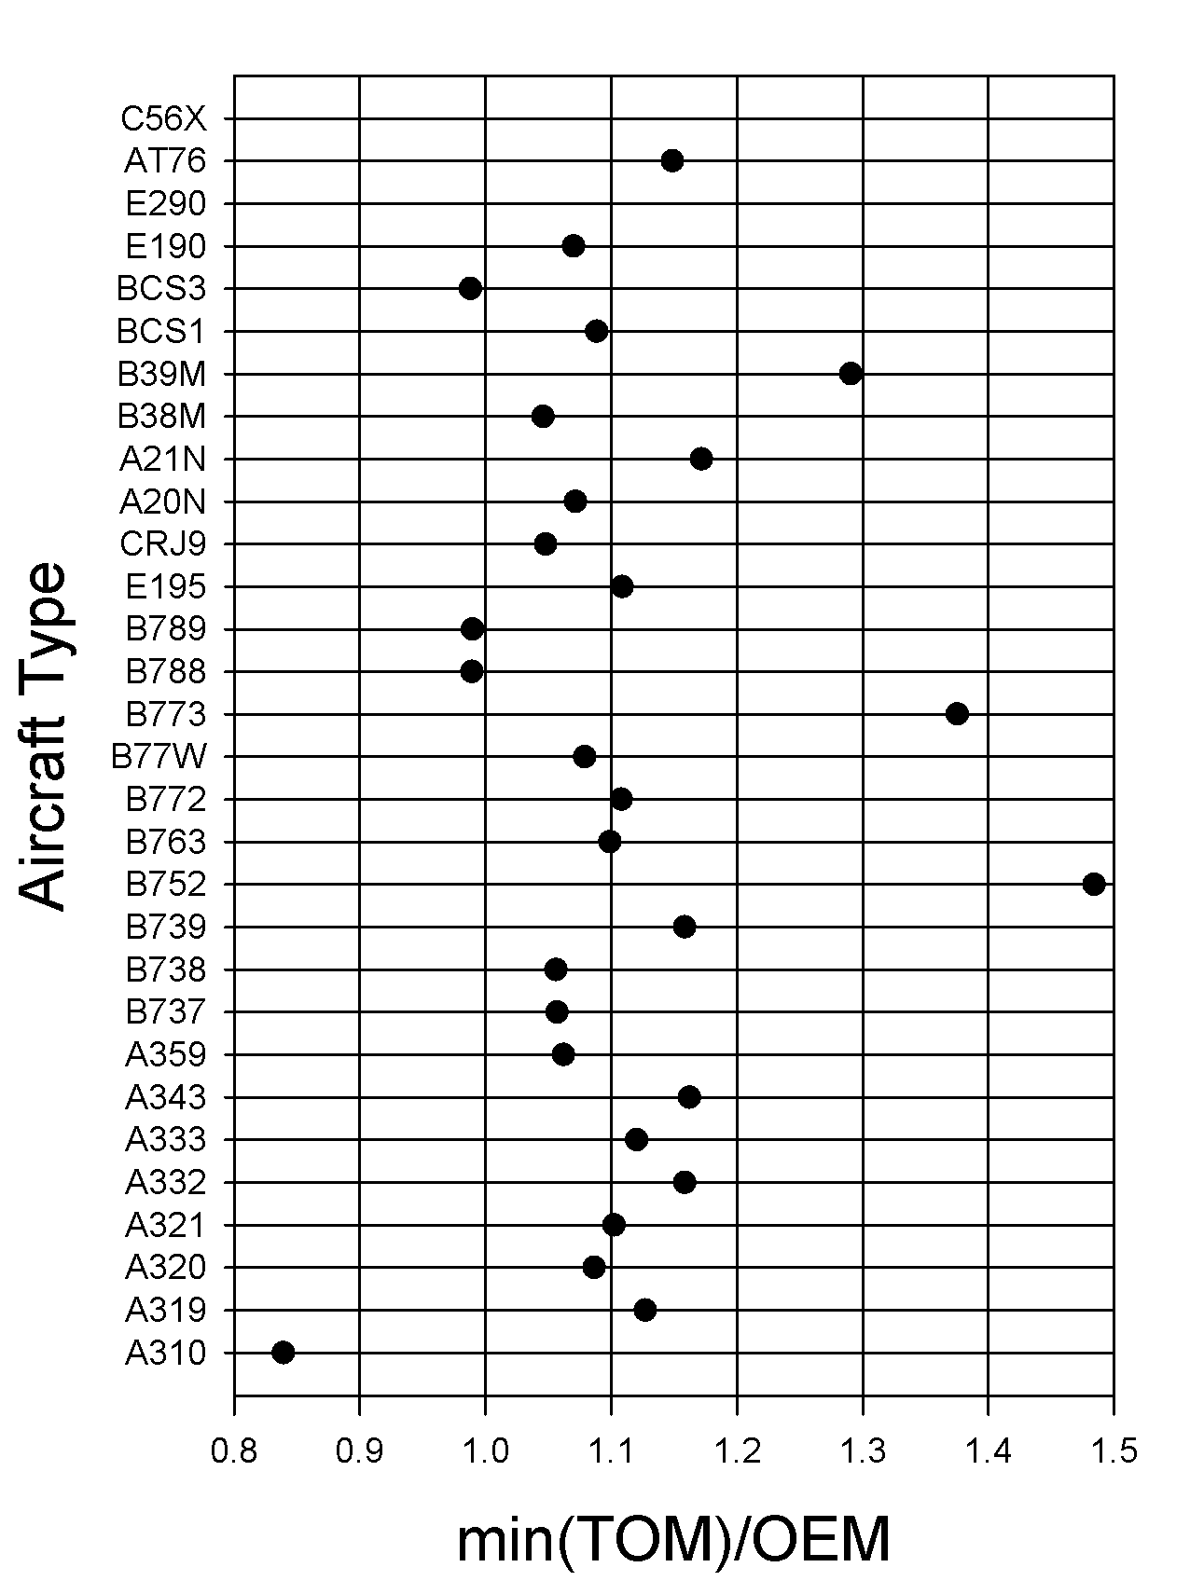
Evidence that the TOM cannot be right in all cases
For some aircraft (e.g. B773), the max(TOM) exceed our MTOM values
Others stay far below our data MTOM value (A310)
For further ones (e.g., A310), the min(TOM) reaches below the OEM

Slide 3
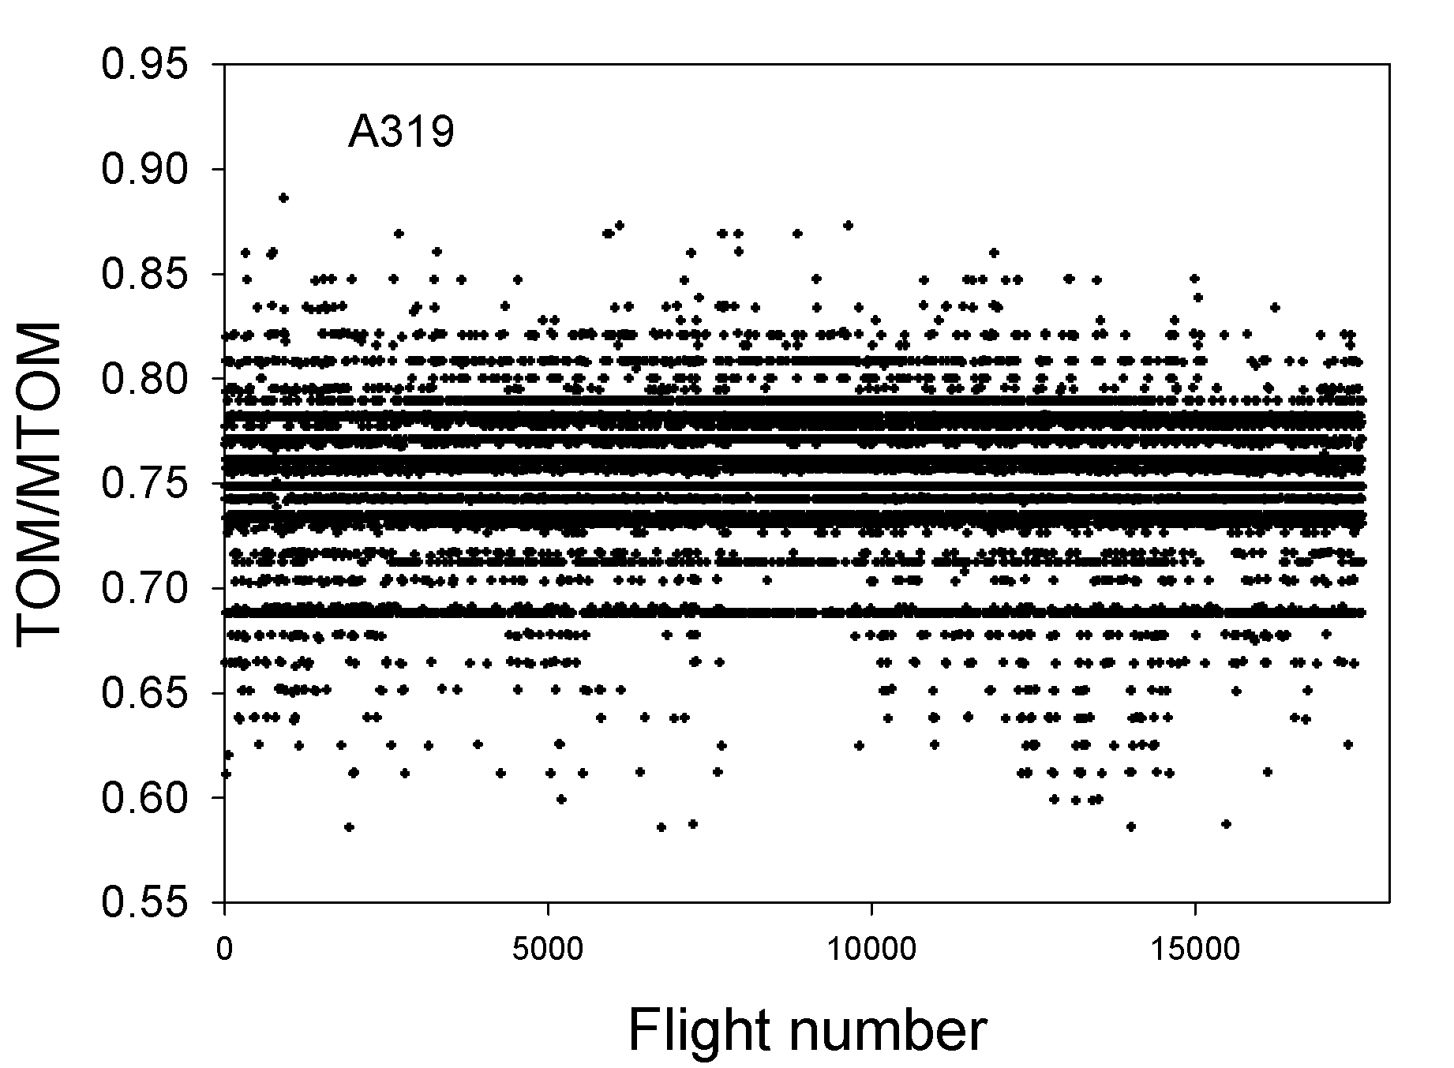
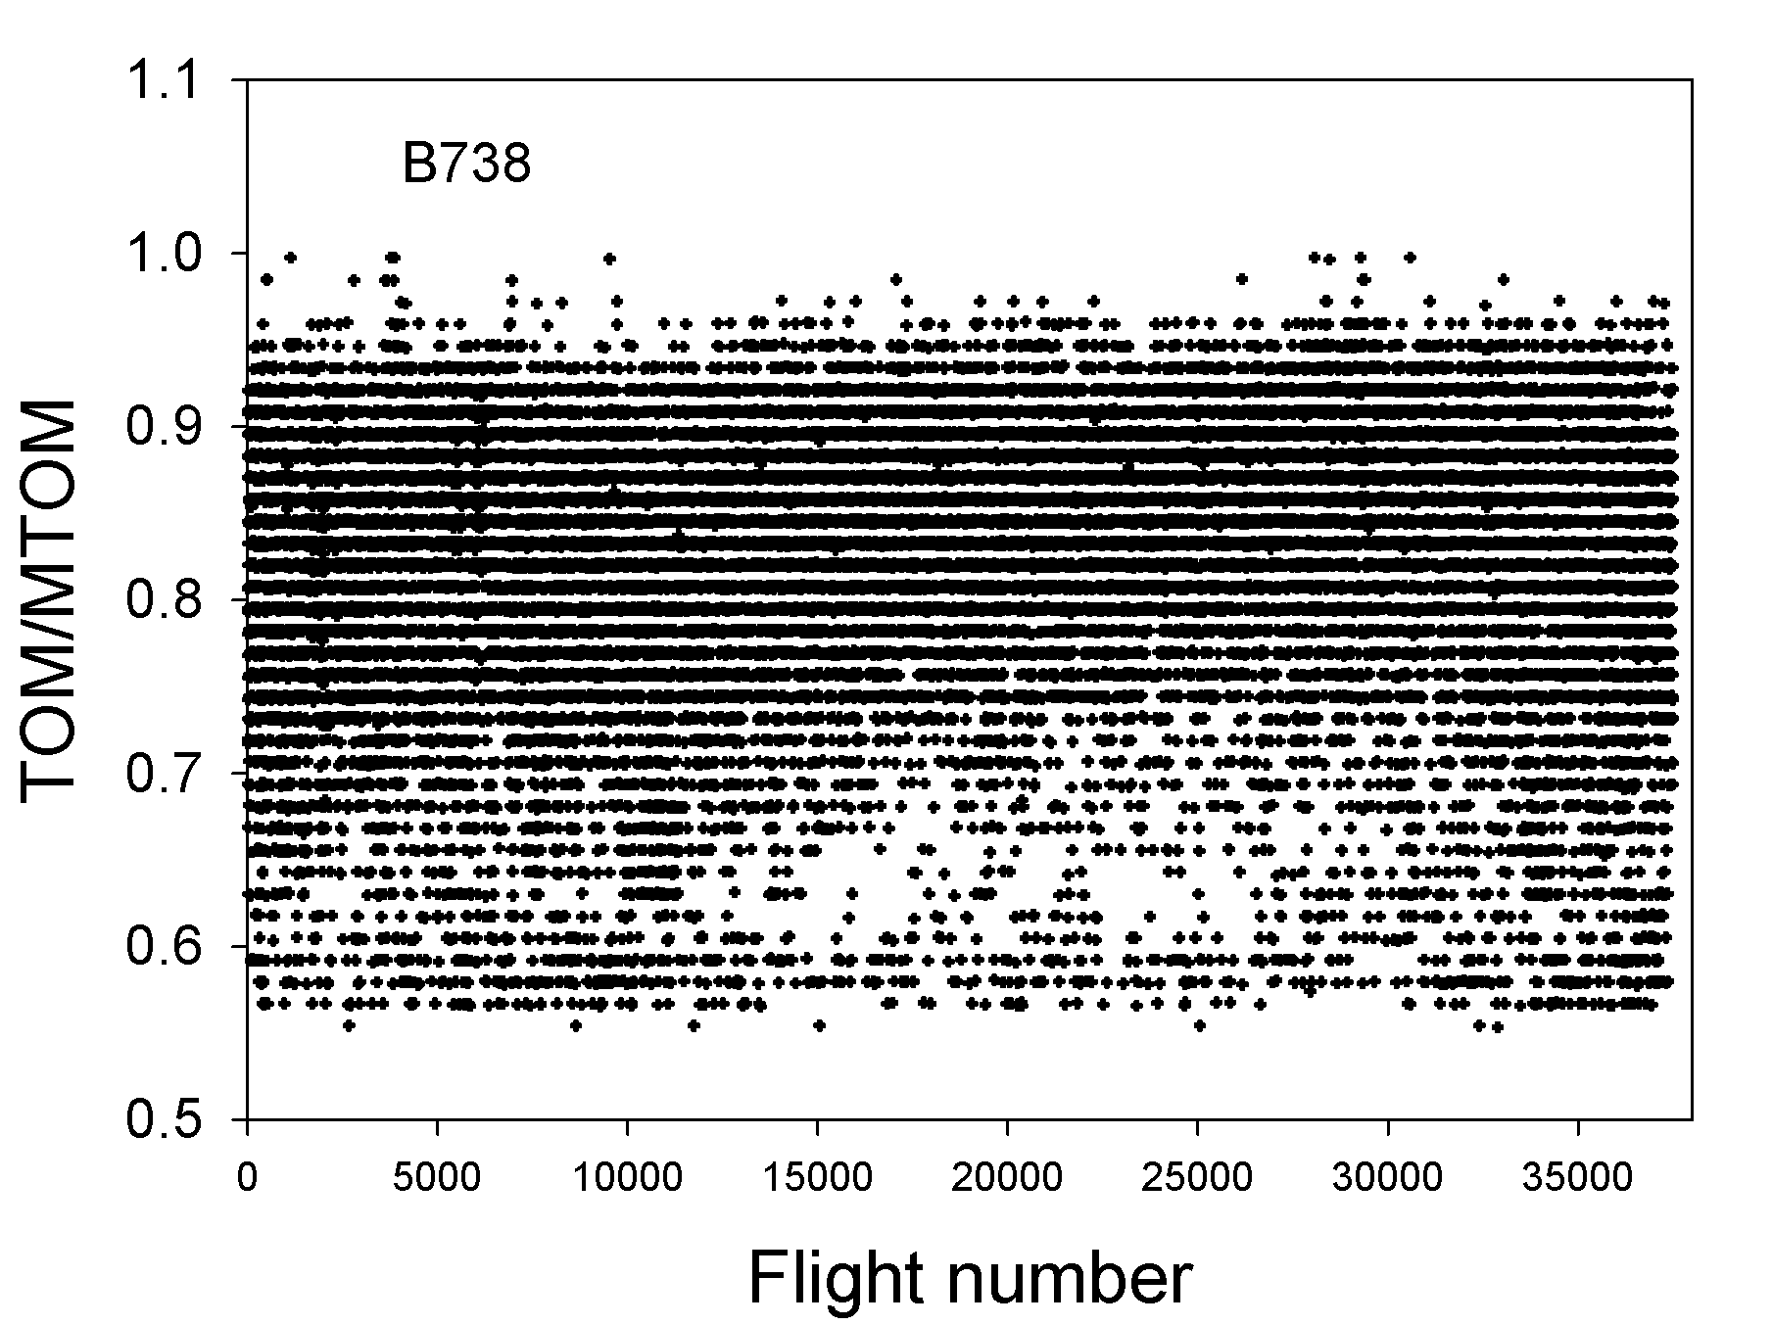
Evidence that the TOM cannot be right in all cases
For some aircraft (e.g. A319 ), the TOM is often close to specific discrete values constantly all over the year.
Others (e.g. the B738) do show far more variability and seasonal dependency .

Slide 4
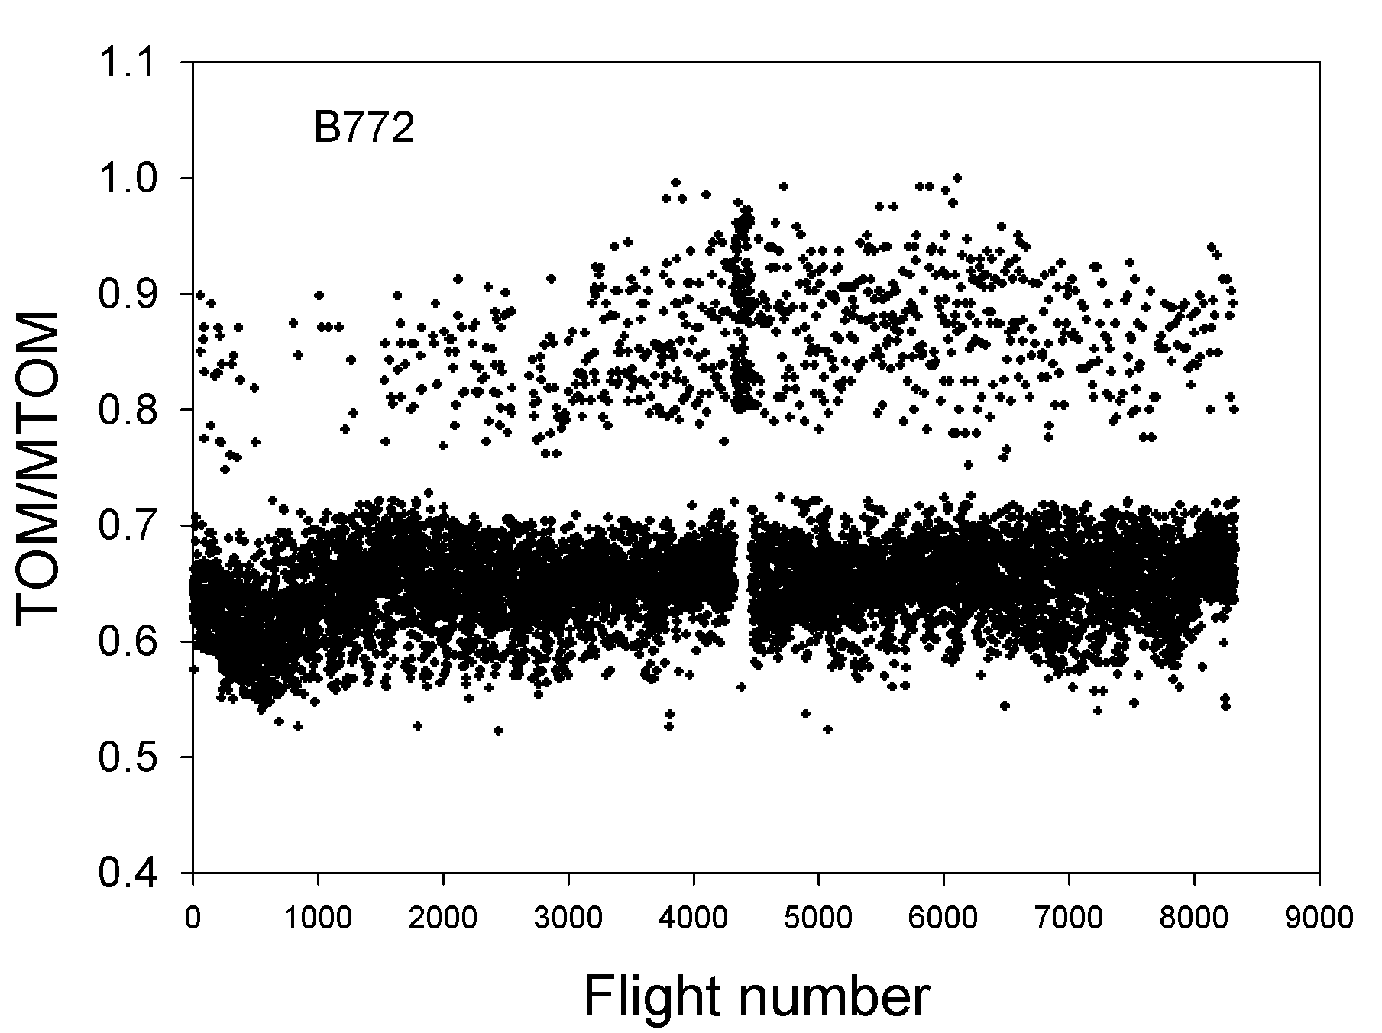
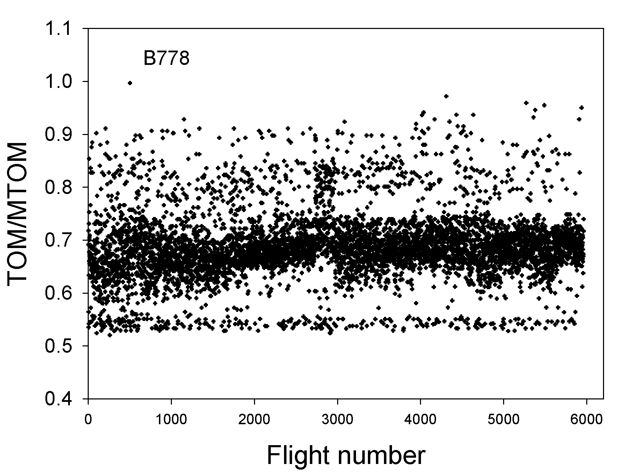
Evidence that the TOM cannot be right in all cases
For some aircraft (e.g., B772 and B778), the TOM is mostly very low, all over the year.
For these two aircraft the TOW derived from the load factor equation shows very large rms errors (about 25%).
The rms errors get reduced and reach an optimum of still 22 % when the only open model parameter (ηL/D)_{o} is increased by 12 %. from its best-estimate PS table value

